Slide 1
Coptic Lesson 1
Coptic Letters that look like English

Slide 2
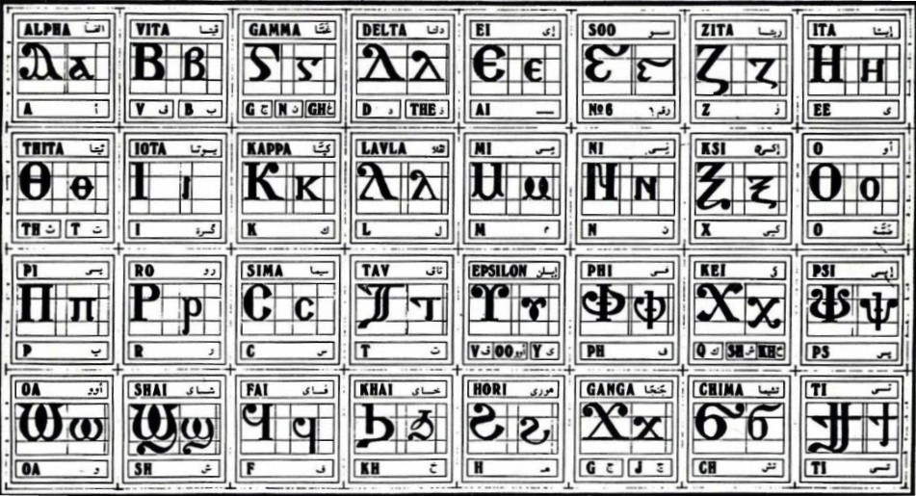
Coptic Alphabets

Slide 3
Letters that look like English
A a = a (Alpha)
B b = b, v (Vita)
E e = e (Ei)

Slide 4
Letters that look like English
Z z = z (Zita)
I i = i (Iota)
K k = k (Kappa)

Slide 5
Letters that look like English
M m = m (Mey)
N n = n (Ney)
O o = o (O)

Slide 6
Letters that look like English
C c = s (Sima)
T t = t (Tav)
W w = oa (Omega)
} ] = ti (ti)

Slide 7
Review
A B E Z I K M N O C T W }
a b e z i k m n o c t w ]

Slide 8
Questions
Coptic
English
Name
M
m
Mey
e
e
Ei
T
t
Tav
w
oa
Omega
z
z
Zita
B
b or v
Vita
A
a
Alpha

Slide 9
Coptic Reading – Part 1
Na ne ni no nw
Ma me mi mo mw
Ba be bi bo bw
Ka ke ki ko kw
Ta te ti to tw
Ca ce ci co cw
Za ze zi zo zw
]a ]e ]i ]o ]w

Slide 10
Coptic Reading – Part 2
an en in on wn
am em im om wm
ab eb ib ob wb
ak ek ik ok wk
at et it ot wt
ac ec ic oc wc
az ez iz oz wz
a] e] i] o] w]

Slide 11
Coptic Words
Coptic Word
Pronunciation
Meaning
abba
abba
abba
Avva
Father
Father
Taoc
Ta-oos
Peacock
Zakaria
Zakaraya
Zakariah
Cwk
Sok
Close
Cina
Seena
Sinai
Antonioc
Antonious
Anthony

Slide 12
Announcement
Class starts at 7:00 PM

Slide 13
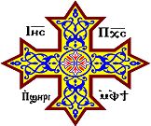
Oujai qen `P[oic

